Slide 1
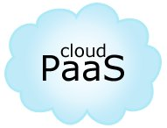
Platform-as-a-Service

Slide 2
Platform As a Service
Computing Platform & Solution Stack
Utility – Metering & subscription model
Support life cycle of building & delivering web applications & services through the platform
Provides collaboration, scalability, databases, security, state management, application versioning among other features
Each platform does not support all software stacks
Restricted environment and not as flexible as IaaS
Ideal platform for quicker development and deployment
Focus on Applications & Business Logic

Slide 3
Elements of PaaS
Multi-tenant architecture
Web services APIs
Tools, Libraries
Development support
Performance analysis, instrumentation
Application Lifecycle Management
Hosting & Deployment
Reporting
Metering

Slide 4
Application Lifecycle
Test
Deploy
Manage
Upgrade
Build

Slide 5
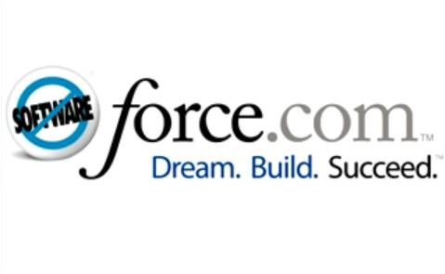
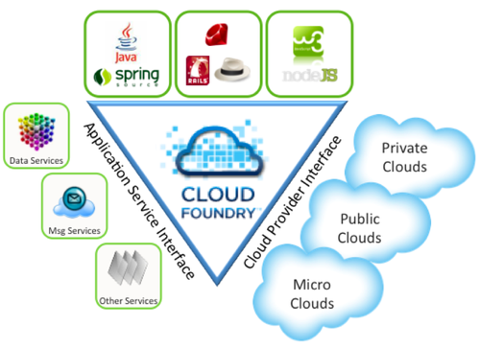


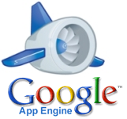
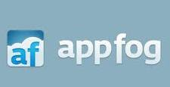
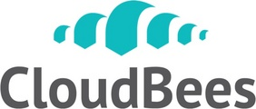
PaaS Vendors

Slide 6
VMware CloudFoundry
Open – Platform as a Service
Frameworks/Software supported:
Java: Spring, Groovy, Grails
Ruby: Rails, Sinatra
Node.js
Python: Django
Databases supported: MongoDB, MySQL & Redis
RabbitMQ, Hyperic
CloudFoundry.com – Hosted PAAS
CloudFoundry.org – Open Source project
Micro Cloud Foundary – Personal PAAS
Open & Extensible – only open PaaS

Slide 7
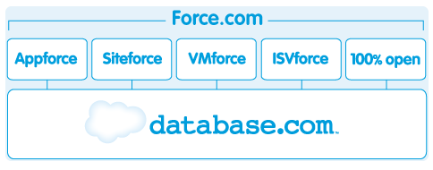
Force.com - 1
Platform-as-a-Service from SalesForce
Targeted towards building business applications across verticals
Database.com
Database as a Service
Mobile, Social and Business Apps

Slide 8
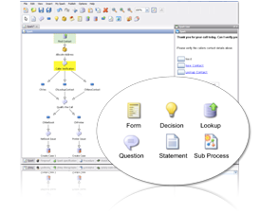
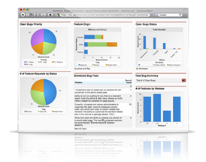
Force.com - 2
AppForce
UI based development with only little coding needed
Workflow Designer
Easily create reports and dashboards

Slide 9
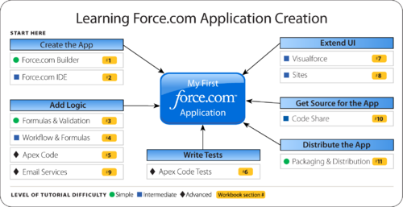
Force.com - 3
SiteForce
Build & Host websites
Content Management
Security
AppExchange
Cloud Computing Marketplace built around Force.com
Vertical specific applications
Tools, connectors, enablers

Slide 10
Google App Engine
Run your applications on Google’s infrastructure
Support for Java and Python stacks
Dynamic web serving
Persistent Datastore with queries, sorting and transactions. Based on Google Big Table
Automatic Scaling & Load Balancing
Google Apps Integration – Email, Docs, etc.
Local Environment for development & testing
Task Queues
Scheduling
Host through <appname>.appspot.com or through your own URL using Google Apps

Slide 11
Google App Engine – Java Support
Java Servlets
JDO/JPA
java.net.URL
javax.mail
javax.cache
Web App Container
Datastore API
URL Fetch
Mail API
Memcache
Scheduled Tasks & Task Queues
Eclipse Plug-in
Administration Console

Slide 12
Google App Engine - Limitations
Limited access to underlying OS
Manage App through the application console
No access to the file storage
No sockets
No threads or timers
No JNI

Slide 13
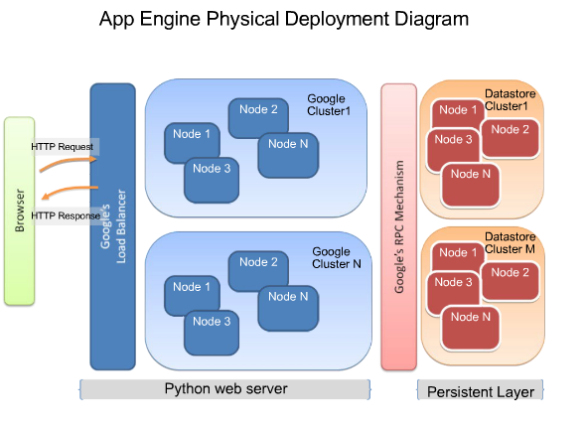

Slide 14
Amazon Elastic Beanstalk
Deploy & Manage applications on AWS platform
Utilize all of the AWS services in an integrated manner
Retain full control of the underlying infrastructure
Flexibility & Control
Support only for Java currently with Tomcat & JBoss application servers
Customized URL - http://myapp.elasticbeanstalk.com/
Free service ! Only the infrastructure is charged
Easy deployment through Eclipse plug-in

Slide 15
AppFog – PHP PaaS
Supports cloud-based hosting for many web application technologies
Based on open source CloudFoundary
PHP, NodeJS, Ruby, Python, Java and .NET
Postgresql, Redis, CouchDB, MongoDB
Introduces the concept of “developer cloud”
Developer does not need to worry about infrastructure or configurations
A service to build, deploy and readily scale applications

Slide 16
Java PaaS
CloudBees
DEV@Cloud – Jenkins as a service
Run@Cloud – Deploy Java EE and Web applications into the cloud
Hence it offers a complete end-to-end environment, from development to production
Works across all IaaS Cloud Vendors
CumuLogic
J2EE PaaS for public & private clouds
Automate the deployment & management of your hybrid J2EE PaaS
Supports JBoss, IBM Websphere, MySQL, Oracle, Apache, Nginx
Has support for Amazon AWS, VMware, Cloud.com

Slide 17
Cumulogic
PaaS for Public & Private Clouds
Use publicly hosted appliance or download installer in local environment
Manage applications in public & private cloud from same product
Federated cloud with applications scaling into the cloud but database in local datacenter
Support for VMWare, Cloud.com, Amazon AWS, OpenStack
Shared services for database servers
Scaling, monitoring, clustering, management – available out of the box for Jboss, Tomcat, Glassfish, MySQL, MongoDB

Slide 18
Microsoft Azure - 1
Internet-scale hosting environment
Web Role: Pre-loaded with IIS, hosts .Net, PHP and Java apps
Worker Role: Without IIS, can be used for any kind of jobs
It provides:
Public & Private Clouds
Administration: Load balancing & failover is provided
Highly available, Scalability
6 datacenters around the world
AppFabric
Cloud Middleware platform for developing, deploying and managing applications on Azure platform
PaaS capabilities

Slide 19
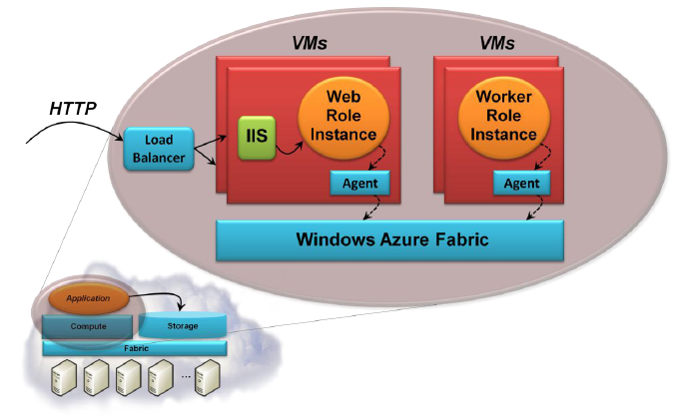
Microsoft Azure - 2
Some interesting services:
SQL Azure: Scalable, distributed, relational database
Service Bus: Secure messaging & distributed systems
Access control – Active Directory support
Integration with BizTalk server to accelerate development on the cloud & providing Business Activity Monitoring & Rules
Sharepoint & Business Intelligence tools

